Slide 1
FUEL-SERVICE STATION
MANAGEMENT
SYSTEM
1

Slide 2
Preamble
This system is about Filling and Service Station Information Management.
Customer currently holding all the data of the system manually . It’s a necessity of the customer to manage the information in an efficient way through an automated system.
We are planning to develop a desktop application using Java Programming language where we will design to store, insert, search, delete data of the system in an efficient and user-friendly way.
Through this automated system we plan to maintain records of the client for years and manage stock order, accounts, invoice with backups and daily/monthly reports.
2

Slide 3
Table of Contents
1. Introduction
1.1 Problem Specification
1.2 Solution Outline
1.3 Key Benefits
2. Objectives
3. Procedure
3.1 Flow of the project
3 3.2 Project Plan
4.Personnel and Facilities
5.Software and Hardware Requirements
6.Budget
7.References
3

Slide 4
INTRODUCTION
Our client is A.P.Gunawardhana and Company (Pvt) Ltd. It is a Service Station with a combination of a Filling Station In Ja-Ela. This Service-Filling Station currently uses a manual system for management and maintenance of critical information. The current system requires numerous paper forms with data stores spread throughout the station infrastructure. The information (on forms) is incomplete, or does not follow management standards. Multiple copies of the same information exist in the station and may lead to inconsistencies in data in various data stores.
4

Slide 5
1.1 Problem Specification
Main Problems that occurs...
High time consumption
Less efficiency
Less productivity
5

Slide 6
Manually updating and eliminating records which are exists in the different places.
When searching particular detail client has to search each and every log respectively.
manually done tasks can lead into a lot of time consumption and mislead to certain decisions, since existing data could be incorrect.
Absence of the report generation process.
When the company tasks are performed there is a need of big workforce.
6

Slide 7
1.2 Solution Outline
We are planning to design a desktop application using java language which will provide all functionalities required by our client..
We also concern about the security of our system. There are many levels of employees in this company. Therefore access levels to the system are specified. E-mail service is also facilitating through this system by using internet.
7

Slide 8
1.3 Key Benefits
One of the main benefits of having this system will be improvement of the efficiency and productivity
This system will provide the information which will be needed to the customer to make decisions or take actions looking at the overall picture of the functionalities rather than digging the information out of the paper system, which may produce more cost and more time.
Through this system client will accomplish in controlling the growth and the creation of the records.
By providing an electronic storage, information of the company will be stored in a more organized manner with the facility of searching records more efficiently and secure that information from unauthorized access.
8

Slide 9
Functional Requirements
Fuel sales and stock management
Service Detail Management
Human Resources Management
Payroll Management
General Account Management
Spare Parts Inventory Management
Supply Controlling Management
Customer and Vehicle Management
9

Slide 10
OBJECTIVES
To automate the functions of service and filling station
Our main objective of this software is to offer a mechanism by which all the operations of the Service station and filling station are executed reliably without any errors. It ensures that the operations carried out daily by the relevant personnel are continuously reviewed by the owner of the company.
10

Slide 11
Specific Objectives
To Implement interfaces for permission controls and allow administration handling.
To create interfaces for entering Employee, Stock and Suppliers details and to retrieve data by Managers and Administrator.
To Create interfaces for entering stock details, supplier details and other relevant operations.
To Implement an In-Out system, emailing system, and a printing facility
To Implement Employee payroll management system.
To Implementing General Accounts Management System
11

Slide 12
PROCEDURE
Flow of the project
1.Requirement gathering and analysis.
2.Design
3. Implementation
4.Testing
12

Slide 13
Project Plan
In order to accomplish the targets of our project we hope to develop the system and its components in the following order.
13

Slide 14
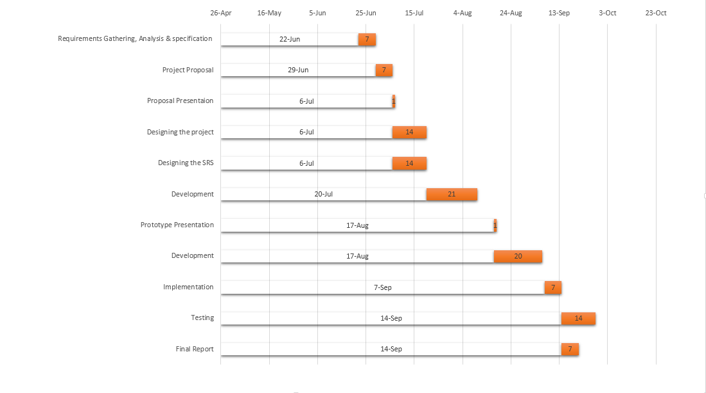
Gantt Chart
14

Slide 15
Personnel & Facilities
PERSONNEL | FACILITIES
T.K.H.Nimeshika | Human resource management Leave management and employee information management. Apply leaves, loans and Medical claim requests. Approve /reject leaves, requests. Handle remaining medical amounts. Employee registration. And Employee details. Report generating(employee wise leave summaries as pending,approved,rejected,no-pay and remaining) User account and user role management.
L.A.Ranasinghe | Fuel sales and stock management Sales billing details management. Tank level management. And Message alerting. Fuel type product details management and Lubricant stock management. Inventory report management
K.B.P.Thabrew | Service station services type details management and billing Create job /tasks for the employees relevant to the services. Services billing and discounts. Resource planning for the services. Generate job card for service station employees for each customer.
H.D.Welikala | Customer and vehicle management Register new customers and customer details. Customer service order details and booking. Product order details and delivery. Credit customer credit details management
15

Slide 16
PERSONNEL | FACILITIES
A.A.M.A.S.S.Perera | Payroll management. Daily attendance Management.. Employee category wise and shift wise salary details including overtime, bonus and no-pay. Issue salary slip with EPF, ETF.
K.S.N.Sucharitharathna | Supply controlling management Supplier details and order management. Replenishment management. Warranty claims. Backup scheduling
R.S.K.I.P.Perdinandis | Generate account management Managing and maintaining the expenses (tax, electricity/water .etc.) And total sales income. Set daily targets and profit margins to compare differences Final account report..
R.C.P.Dissanayaka | Spare parts management Managing stock level and ordering the spare parts and message alerting at critical levels. Spare parts sales details and purchase order and supplier details management. Spare parts inventory reports.
16

Slide 17
Software and hardware requirements
Software Requirements
Operating System | Microsoft Windows XP (32-bit or 64-bit) Windows Vista ((32-bit or 64-bit) Windows 7 ((32-bit or 64-bit) Windows 8 ((32-bit or 64-bit)
Browser | Internet explorer Chrome other recommended browser
Software Tools – Java, My SQL, phpMyAdmin
17

Slide 18
Hardware Requirements
Hardware requirements of PC.
(Minimum configuration client workstation only.)
Machine | X86 (32-bit) | X86-64 (64-bit)
CPU | Operation system dependent | Operation system dependent
Memory | 1GB | 2GB
Video | 1024x768, 16-bit color | 1024x768, 16-bit color
Mouse | Microsoft or compatible | Microsoft or compatible
Hard Disk | 200 MB (no local data set) | 200 MB (no local data set)
18

Slide 19
Fax machine and Printer - | Email fax services are one of the part in our system, with this when submitting the document from user to the client we will send the fax to the destination. And when we issuing bills to the customer we use a normal desk jet printer.
19

Slide 20
Budget
Selection Process
Transportation Costs | 6,000.00
Other Expenses | 5,000.00
Total | 11,000.00
20

Slide 21
THANK
YOU
Done By:
T.K.H.Nimeshika
L.A.Ranasinghe
K.B.P.Thabrew
H.D.Welikala
R.S.K.I.P.Perdinandis
K.S.N.Sucharitharathna
A.A.M.A.S.S.Perera
R.C.P.Dissanayaka
21

